Slide 1
Experiment_5
Process Management using System Calls

Slide 2
Process Creation
Parent process create children processes, which, in turn create other processes, forming a tree of processes
The process which creates other process, is termed the parent of the other process, while the created sub-process is termed its child.
Each process is given an integer identifier, termed as process identifier, or PID. The parent PID (PPID) is also stored for each process.

Slide 3
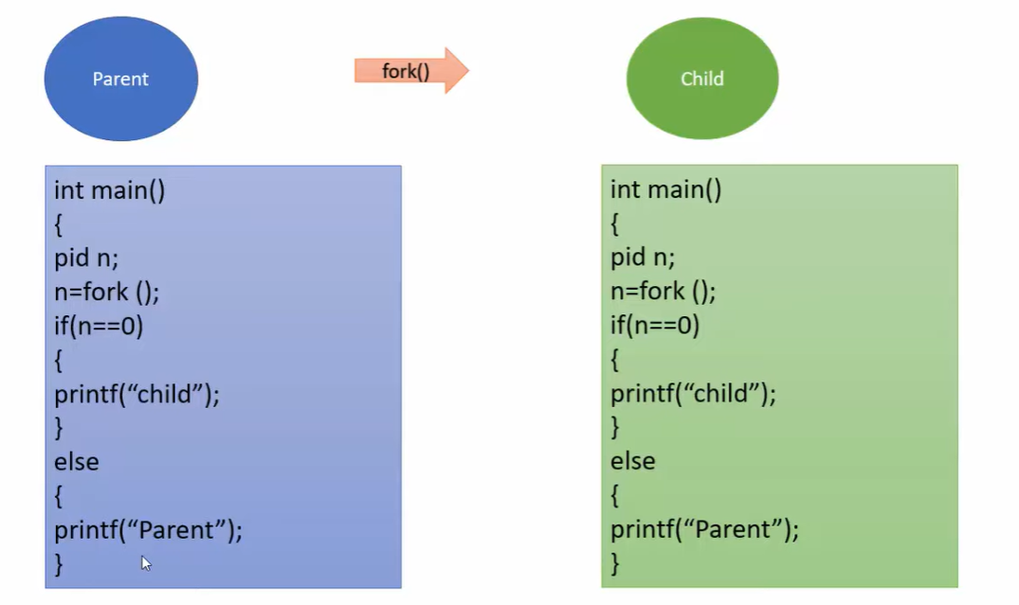

Slide 4
UNIX examples
fork () system call creates new process
exec() system call used after a fork to replace the process’ memory space with a new program

Slide 5
fork()
System call fork() is used to create processes.
It takes no arguments and returns a process ID.
The purpose of fork() is to create a new process, which becomes the child process of the caller.
After a new child process is created, both processes will execute the next instruction following the fork() system call.

Slide 6
This can be done by testing the returned value of fork():
If fork() returns a negative value, the creation of a child process was unsuccessful.
fork() returns a zero to the newly created child process.
fork() returns a positive value, the process ID of the child process, to the parent.

Slide 7
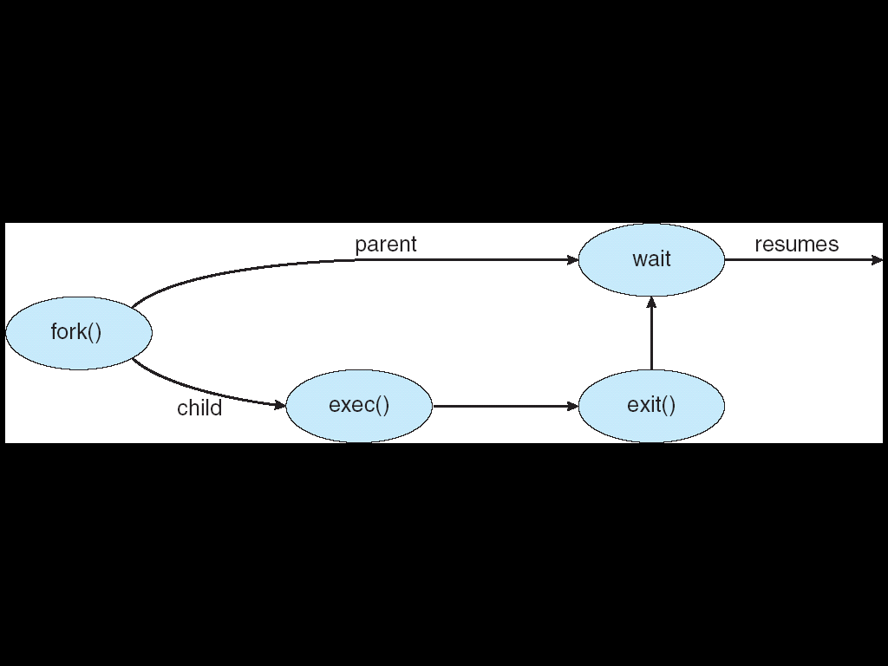

Slide 8
Learning Objectives:-
Creating Child Process using Fork () system call
Accessing process ID and parent process ID using getpid() and getppid() system call
By the end of this experiment, students will learn about different system commands used to manage
processes. They will also gain an understanding of orphan and zombie processes.

Slide 9
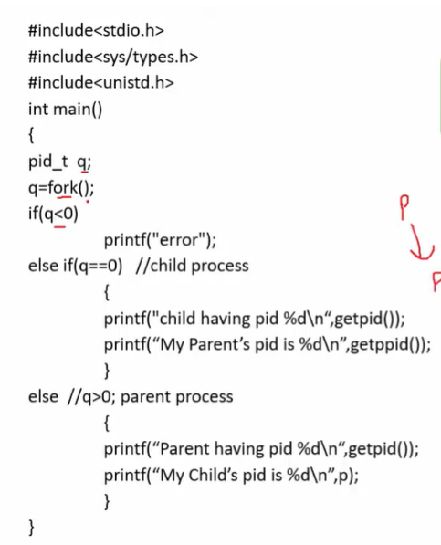

Slide 10
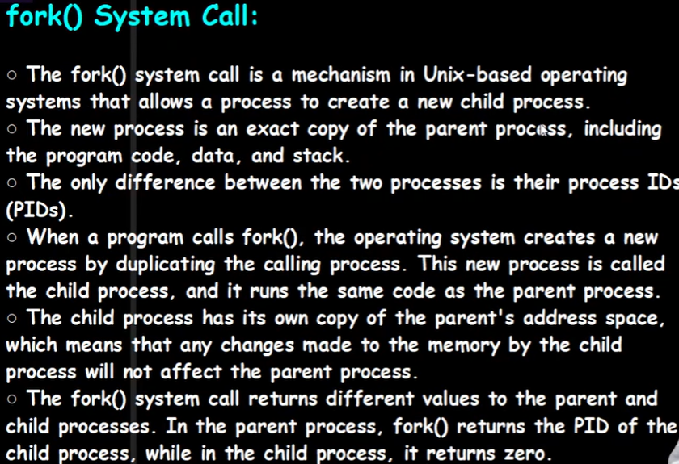

Slide 11
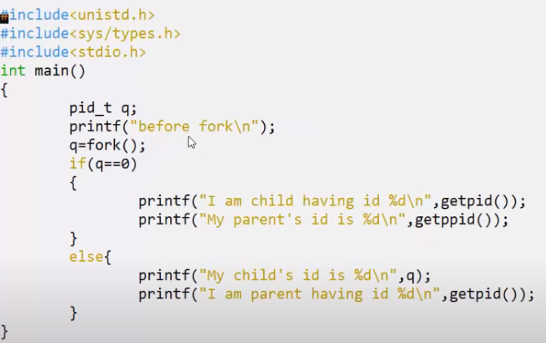
How to create child process using fork() || Duplicate Process

Slide 12
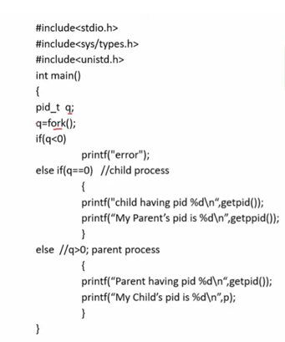

Slide 13
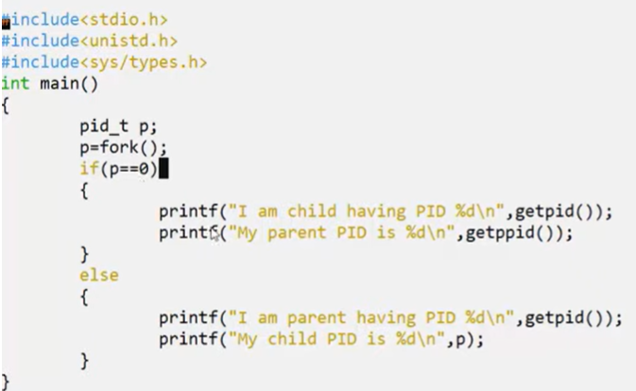
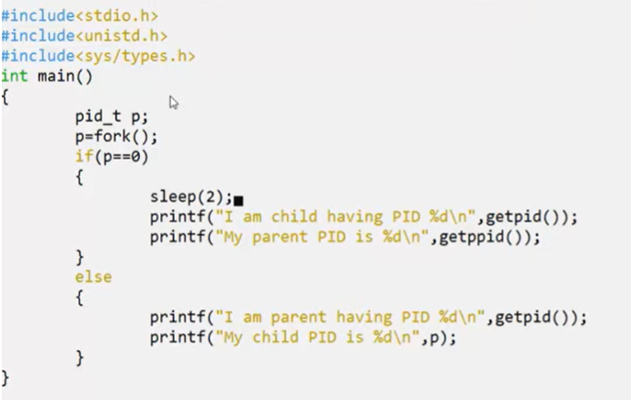
Orphan Child

Slide 14
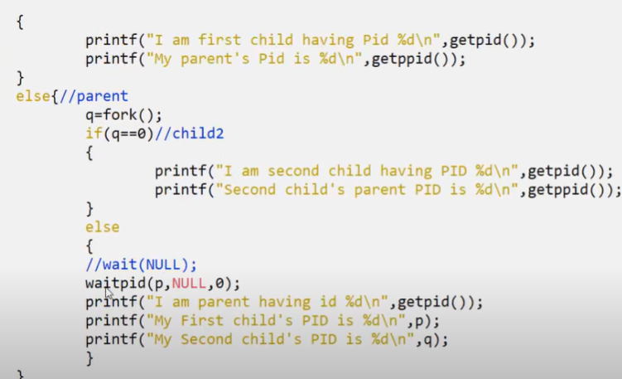
Wait for a particular child

Slide 15
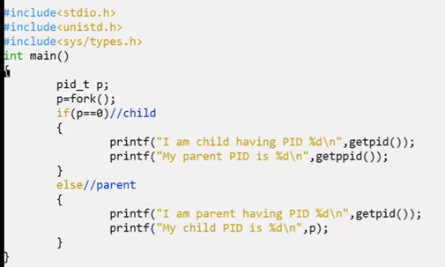
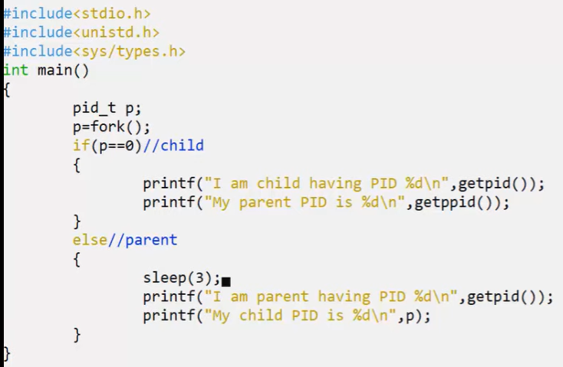
Zombie Process Program

Slide 16
Exercise

Slide 17
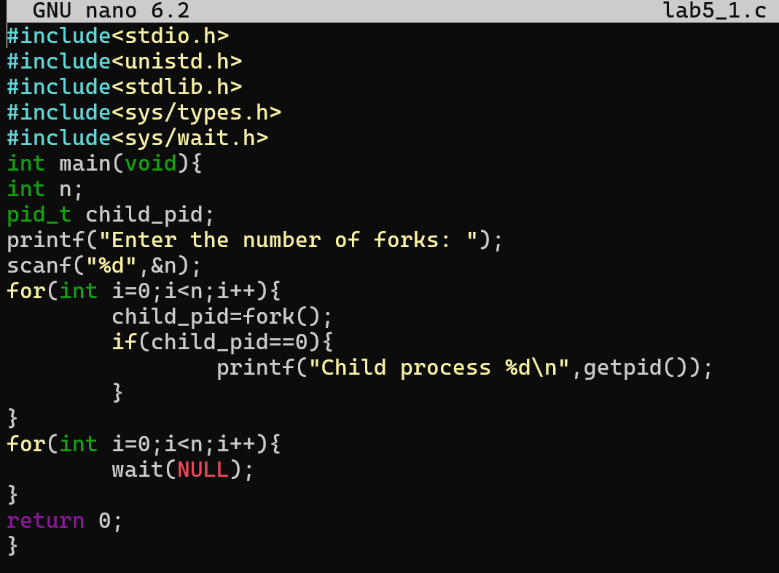
Exercise 1: Write a C program to illustrate that performing ’n’ consecutive fork() system calls generates a total of 2n − 1 child processes. The program should prompt the user to input the value of ’n’.”

Slide 18
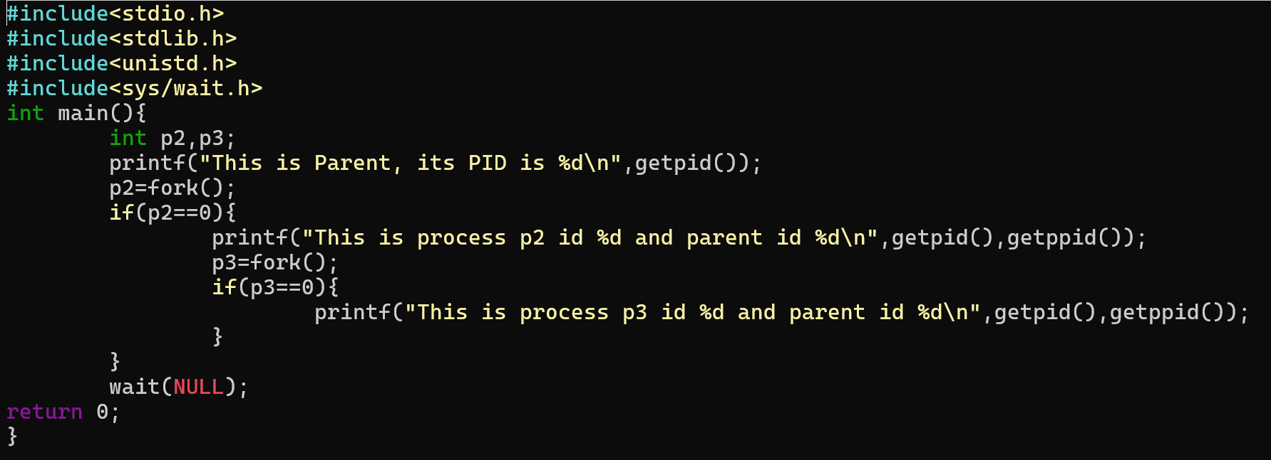
Exercise 2: Write a C program utilizing the fork() system call to generate the following process hierarchy: P1 → P2 → P3. The program should display the Process ID (PID) and Parent Process IDs (PPID) for each process created.

Slide 19
